Slide 1
Machine Learning Based Age Prediction of Coconut
Guided By
Dr. Jose Joseph
Assistant Professor
IIITMK
By
Parvathy H
Reg No: 31020024
M.Sc Machine Intelligence
IIITMK

Slide 2
Overview
Introduction
Motivation
Aim, Scope and Approach
Literature Review
Data
Classification
Object Detection
Results & Discussions

Slide 3
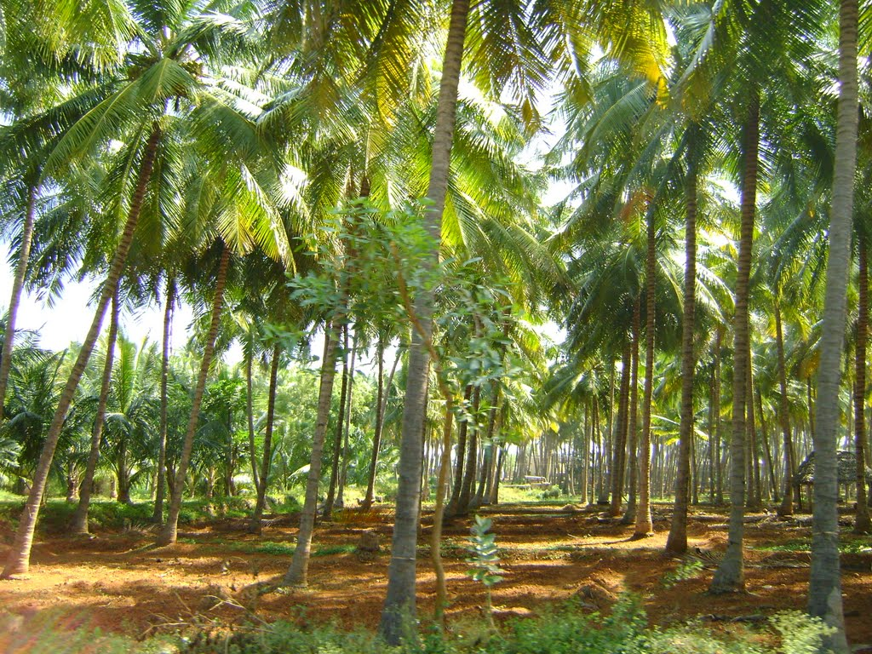
Introduction
Coconut - Kerala’s most important cultivated crop
Challenges to coconut cultivation - lack of skilled labor, high wage rate
Coconut in different age - suitable for different uses
7-9 months : Tender
Greater than 12 months : Mature
High expertise needed to correctly predict the age
Better technology adoption - need of the hour
Challenging problem - presence of leaves, stalks, similar background
Source: https://mapio.net/pic/p-54276565/
Machine Learning Based Age Prediction of Coconut

Slide 4
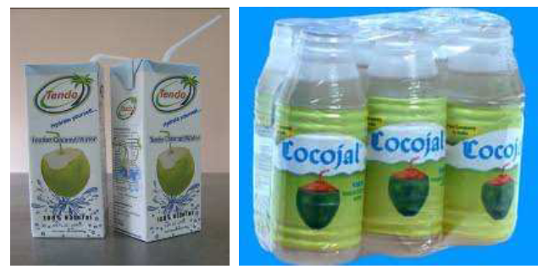
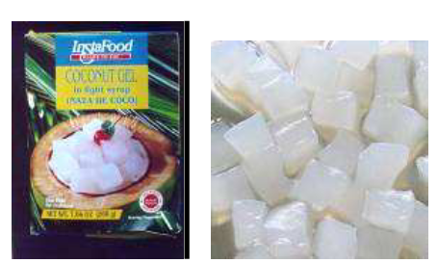
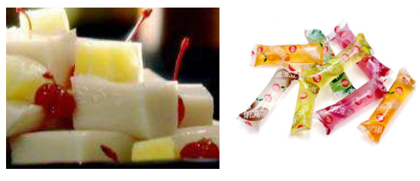
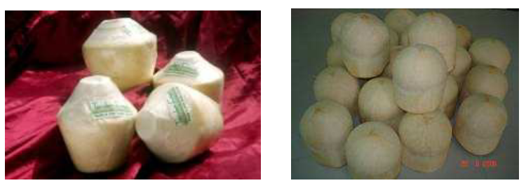
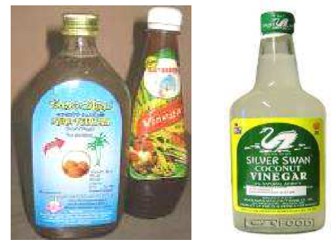
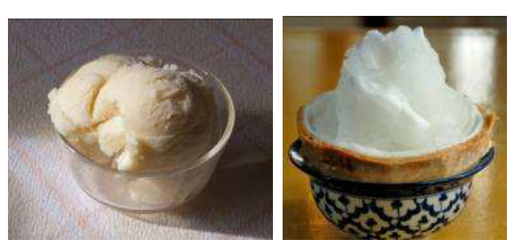
Motivation
Coconut at different stages of development – suitable for different purpose
Time consuming & cumbersome traditional methods
High expertise & skill needed
Timely harvesting – better commercial possibilities
Need for correctly ascertaining age of coconut
Machine learning based age prediction as tender or mature can help
Initial step to fully automated coconut harvesting
Value added products from coconuts. Source: https://www.coconutboard.in/docs/article-valueaddition-director.pdf
Machine Learning Based Age Prediction of Coconut

Slide 5
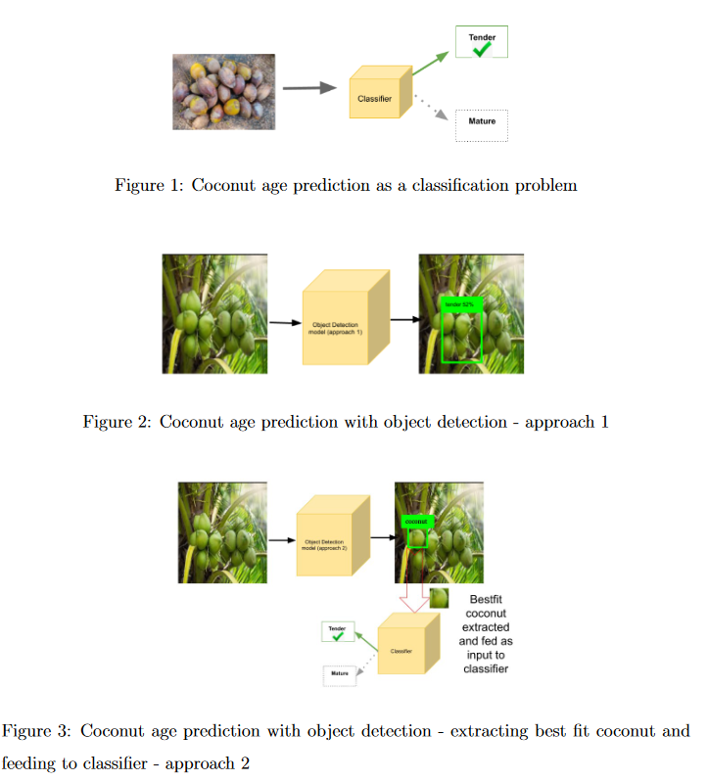
Aim, Scope and Approach
Classify coconut as tender or mature
Analyse different solutions
As a classification problem – based on provided image data
Sample android app
As an object detection problem – natural settings, background, presence of leaves, stalks etc
Approach 1: Object detection with class prediction as tender or mature
Approach 2: Detect “best-fit” coconut 🡪 extract 🡪 classify
Machine Learning Based Age Prediction of Coconut

Slide 6
Literature Review
Thamban K.P. and D. Jaganathan.
Better technology adoption can improve productivity in coconut cultivation
Parvathi Subramanian and Tamil Selvi Sankar
Image processing techniques alone - unable to detect all varieties of coconuts, complexity in the environment
Faster R-CNN with ResNet-50 model for coconut detection in two major maturation
Chiagoziem C. Ukwuoma et al.
Computer Vision, deep learning for fruit detection and classification
Tan et al
EfficientNet, EfficientDet - scaling CNNs for efficient models for resource constrained devices
Machine Learning Based Age Prediction of Coconut

Slide 7
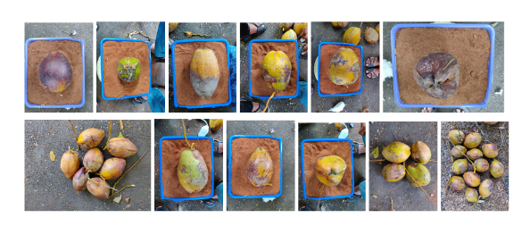
Data
Coconut image dataset containing a total of 999 images of tender and matured
Data preparation
Split to train, validation, test images (80%, 10%, 10% )
Object detection: Bounding box drawn, labelled and converted to xml
Fig 4: Results from classifier based on EfficientNetLite0. Accuracy : 90%
Machine Learning Based Age Prediction of Coconut

Slide 8
Classification
Transfer learning was relied upon
Classifier built from pre-trained models
VGG16
ResNet50
EfficientNet-Lite0
Trained ResNet50 model incorporated into sample android app
Machine Learning Based Age Prediction of Coconut

Slide 9
Object Detection
Object detector with bounding box, class label and confidence level
Attempt to build Faster-RCNN object detector
EfficientDet-Lite0 based
Proposed method: Best-Fit coconut detection followed by classification
Decouple object detection and class prediction
Decrease model complexity
Improve accuracy
Detect best-fit coconut
Extract best-fit coconut
Feed to classifier
Predict as tender/mature
Machine Learning Based Age Prediction of Coconut

Slide 10
Results & Discussions
Models created were able to predict the age of coconuts with varied success rates
Classifier model produced better results compared to object detection model
Machine Learning Based Age Prediction of Coconut

Slide 11
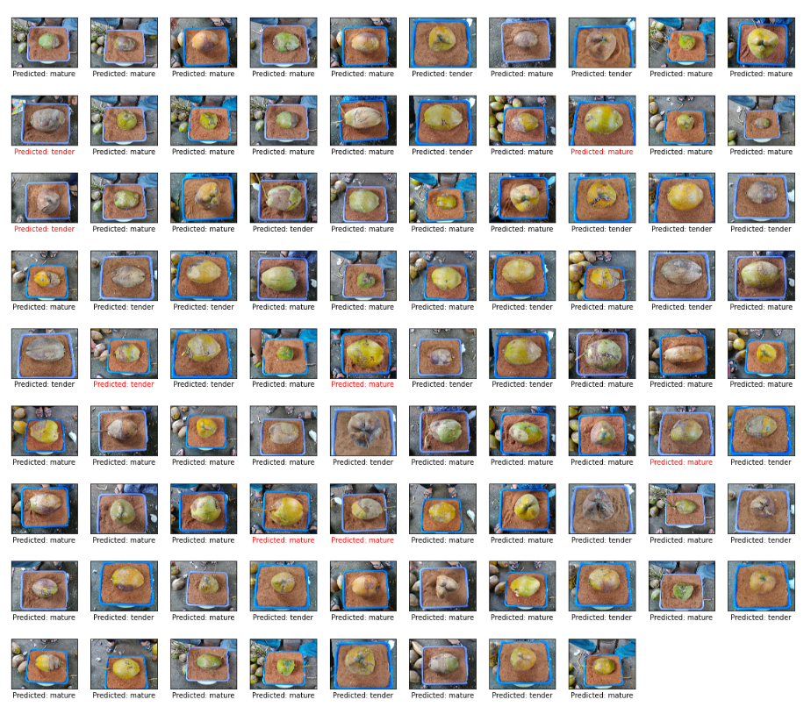
Results & Discussions - contd
Fig 5: Results from classifier based on EfficientNetLite0. Accuracy : 90%
Machine Learning Based Age Prediction of Coconut

Slide 12
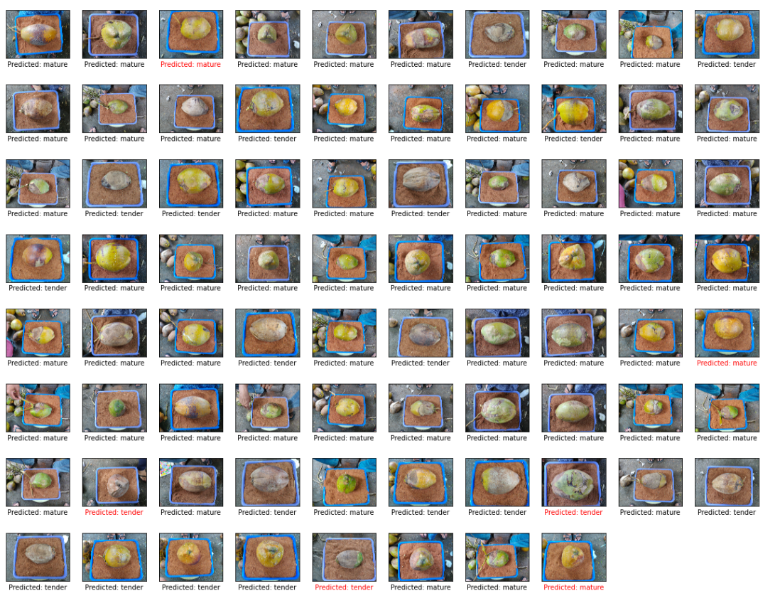
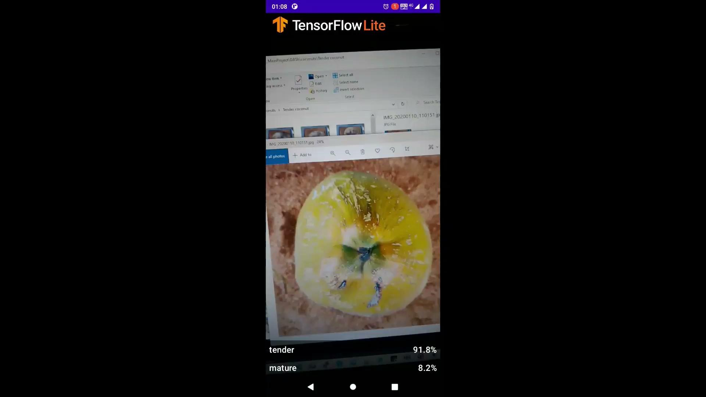
Results & Discussions - contd
Video: Working of sample android app https://drive.google.com/file/d/1GKL2DEoNGASyDXl1YgVm9In_DhtM44ym/view?usp=sharing
Fig 6: Results from classifier based on ResNet50. Accuracy : 93%
Machine Learning Based Age Prediction of Coconut

Slide 13
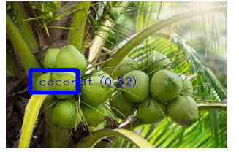
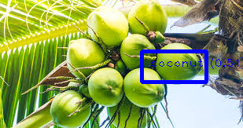
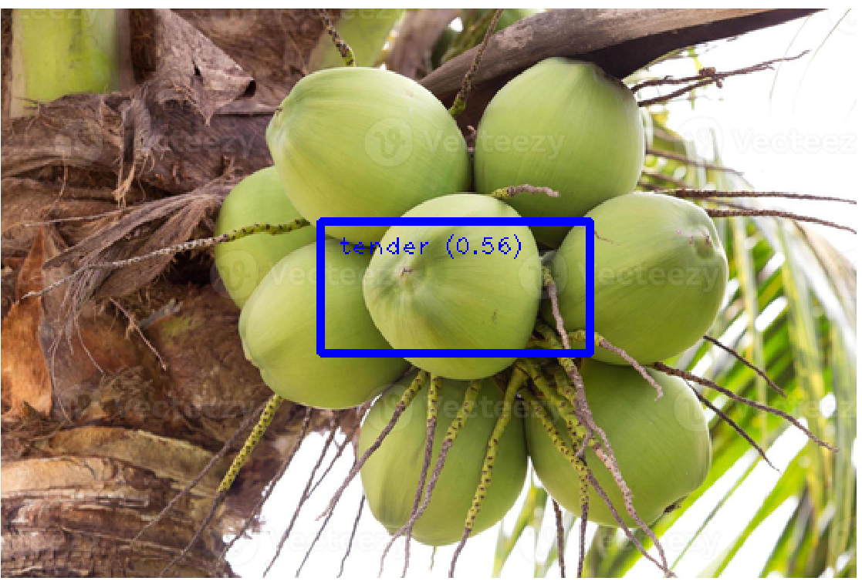
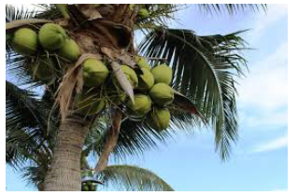
Results & Discussions - contd
Fig 7: Result from inference performed using object detector based on EfficientDet-Lite0
Model | AP at IoU=.50
Object detection with classification as tender/mature (EfficientDet-Lite0) | 0.007538254
Object detection as coconut only (EfficientDet-Lite0) | 0.28234622
Fig 8: Result from inference performed using object detector based on EfficientDet-Lite0- detect as coconut only, no classification
Machine Learning Based Age Prediction of Coconut

Slide 14
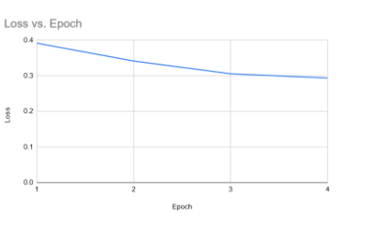
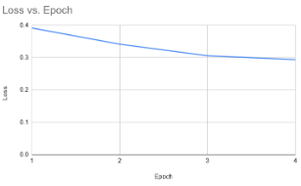
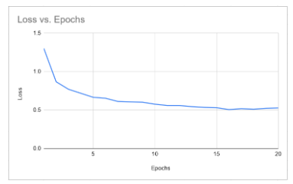
Results & Discussions - contd
Fig 9: for classifier model based on EfficientNet-lite0
Fig 10:For classifier model based on ResNet50
Fig 11: for object detection model based on EfficientDet-lite0
Machine Learning Based Age Prediction of Coconut

Slide 15
Future Work
Expand dataset to improve results
With known bunches of coconut in tender/mature class
Include coconuts of different varieties, colour
Best-fit coconut based object detection
Decouple object detection and classification, decrease model complexity
Improve accuracy
Machine Learning Based Age Prediction of Coconut

Slide 16
References
Thamban K.P. and D. Jaganathan. “Coconut production in Kerala” in Indian Coconut Journal. In: (Aug. 2016).
Subramanian Parvathi and Sankar Tamil Selvi. “Detection of maturity stages of coconuts in complex background using Faster R-CNN model”. In: Biosystems Engineering 202 (2021), pp. 119–132. issn: 1537-5110. doi: https://doi.org/10.1016/j.biosystemseng.2020.12.002. url: https://www.sciencedirect.com/science/article/pii/S1537511020303329
Tensorflow. Training Custom Object Detector. url: https : / / tensorflow - object - detection-api-tutorial.readthedocs.io/en/tensorflow-1.14/training.html
Dr Hemalatha Nambisan and Dr Rajesh M K. “Coconut”, Mendeley Data, V1. doi:10.17632/mmc345tfjw.1

Slide 17
Thank you

